Slide 1
RC Car Workshop:
DC Motor Drivers/ Motors
Week 2!

Slide 2
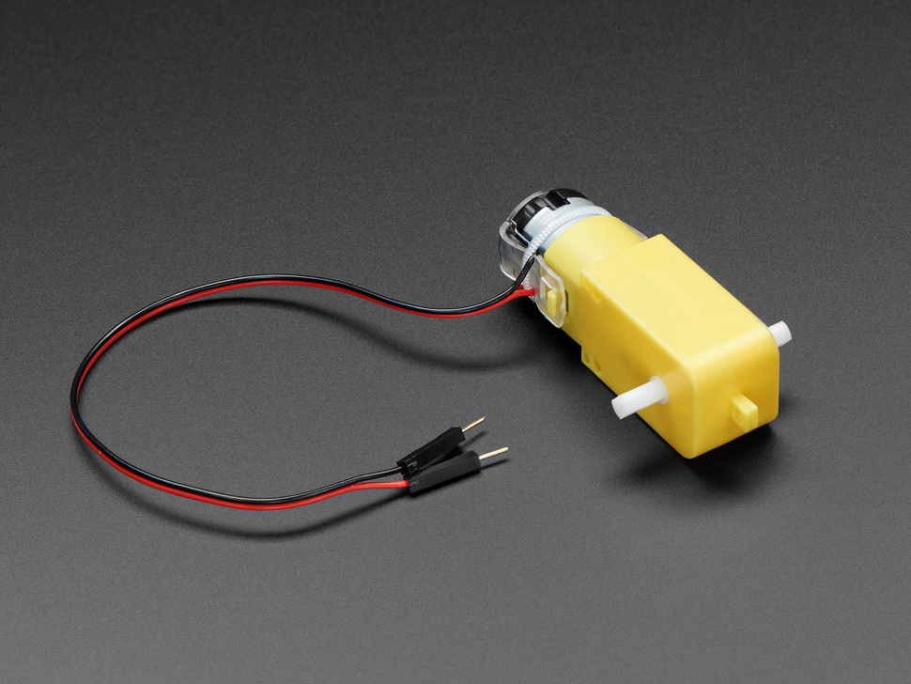
What are DC Motors?
A.K.A. Direct Current Motor. Has a positive and negative lead.
RED +
BLACK -
Several ways to power it. DO NOT control directly from Arduino!
First step is just power supply. Then we want to move the motor.
Control the direction for the DC motor w/ motor driver

Slide 3
How control of a DC Motor achieved?
Need to combine 2 techniques:
PWM (Pulse Width Modulation) = allows us to control the speed of the motor
H-Bridge = control the rotation direction

Slide 4
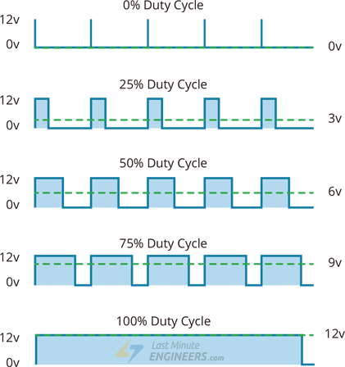
PWM (Pulse Width Modulation)
PWM
Adjusts speed by sending a series of on/off pulses
Image source

Slide 5
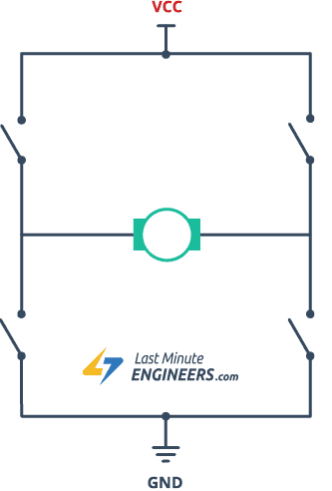
H-Bridge
Direction controlled by reversing the current (changing polarity)
Circuit consists of 4 switches w/ motor in the center (looks like an H lol)
Specific switches change at certain times–changes polarity
GIF source

Slide 6
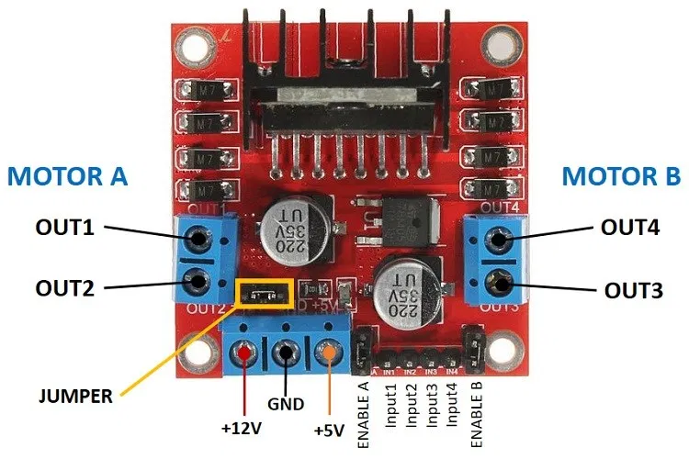
DC Motor Drivers
Several motor drivers combine these techniques. We’ll be using the L298N Motor Driver.

Slide 7
PIN Layout
The motor driver has a two terminal block in each side for each motor. OUT1 and OUT2 at the left and OUT3 and OUT4 at the right.
OUT1: DC motor A + terminal //Move the motor clockwise (Forward)
OUT2: DC motor A – terminal //Move the motor counterclockwise (Backwards)
OUT3: DC motor B + terminal //Samething but for motor B
OUT4: DC motor B – terminal

Slide 8
PIN Layout cont.
12v Pin allows us to power the motor if the voltage being provided is above 5v or 12v exactly
GND is used to ground the driver
5v is used to power the circuitry inside the driver, this is usually connected to the arduino’s VIN pin

Slide 9
PIN Layout cont.
These pin control the direction of the tmoros
IN1: Input 1 for Motor A //Move the motor Clockwise(Forward)
IN2: Input 2 for Motor A //Move the motor Counterclockwise(Backward)
IN3: Input 1 for Motor B //Same thing but for motor B
IN4: Input 2 for Motor B
The following pins control the speed of the motor. The module usually comes with a jumper on these pins allowing the motors to constantly be at max speed. If you want to control the actual speed then remove the jumpers and connect them to the PWM labeled pins on the arduino
ENB: speed of Motor B
ENA: speed of Motor A

Slide 10
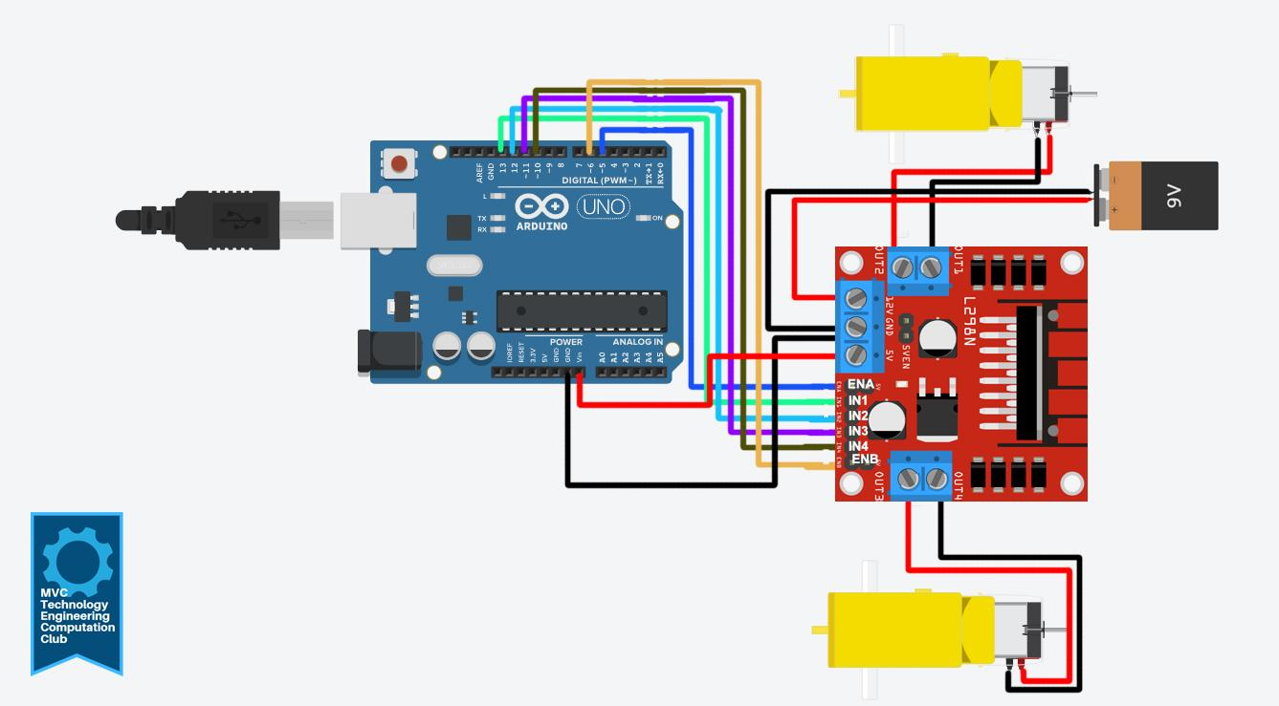
Circuit With Speed Control
IN1 = 13
IN2 = 12
IN3 = 10
IN4 = 11
ENA = 5
ENB = 6
OUT 2 = Ground Motor A
OUT 1 = Power Motor A
OUT 4 = Power Motor B
OUT 3 = Power Motor 3
12v = 9V Battery Connector RED
GND = 9V Battery Connector Black and Ground to arduino GND
5v MOTOR DRIVER = VIN on arduino
CLICK ON IMAGE FOR FULL VIEW

Slide 11
Code
https://tinyurl.com/28x7jwte

Slide 12
SOURCES
How to use the L298N Motor Driver - Arduino Project Hub
In-Depth: Interface L298N DC Motor Driver Module with Arduino
Controlling DC Motors with the L298N H Bridge and Arduino

